Slide 1
myHR Login
1. myHR Setup
2. Password Reset PIN
3. User Profile Page
Last update : 17.08.2026

Slide 2
Table of Contents
  myHR Web Browser - Initial Setup
  Request for myHR Account activation
  Setup your myHR Account & 2FA (For iOS Users)
  Setup your myHR Account & 2FA (For Android Users)
  myHR Mobile App
  Login to myHR Mobile App
  Download myHR Mobile App (for Huawei phones without Google services)
  Activate Multiple Profile Feature in myHR Mobile
  Reset myHR Mobile Profile after 6 months Expiry
  myHR Web Browser (After Initial Setup)
  Login to myHR Web Browser
  Activate your Password Reset PIN
  Change your password using corporate email
  Change your password using Password Reset PIN
  Change your password using User Profile Page
  Reset password after 6 months password expiry
  Change your Password Reset PIN using User Profile Page
  Change/ deactivate your 2FA device using User Profile Page

Slide 3
myHR Support Mode
s/n | Purpose | Email to IT Service Desk | Call IT Service Desk Hotline | Self Help
1 | myHR enquiry | Yes | Yes | myHR Portal
2 | For 1st time login to myHR | Yes | Yes | Default Password (expires after 14 days): Last four character of your NRIC (in uppercase for the alphabet), your Birthdate (DDMMYYYY) and !nuhs (E.g. 123A11041980!nuhs)
3 | Request Password for browser login | Yes | Yes | Click “Forget Password” at login page: Using CorporateEmail or Password Reset PIN
4 | Request Deactivation of 2FA Passcode (TOTP) | Yes | Yes | Go to User Profile Page: using Current Password and 2FA code on old mobile device
5 | Request Password Reset PIN | No | No | Go to User Profile Page: Update new Pin code for Password Reset Pin using Current Password (12 chars)
6 | Request myHR Account unlock | Yes | Yes | No

Slide 4

Terminology Used

Slide 5
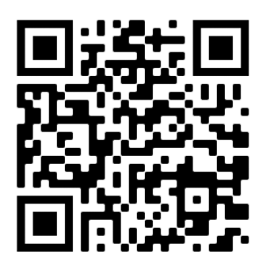


Terminology Used in myHR
SF Terminology | Description | Reference
SuccessFactors | myHR system https://hcm44.sapsf.com/login?company=NUHS | Login to myHR Browser Page using corporate workstation on company network or via HVPN
SuccessFactors Mobile App | myHR mobile Application
Authenticator Mobile App** | SAP Authenticator App which will generate the 6-digit OTP for Two Factor Authentication for login to myHR browser page. To enter this passcode after entering the login password. You need to deactivate the authenticator app when you change new mobile device by calling IT Service Desk (if you forgot password) or login to User Profile Page to deactivate. | Alternatively, you can also use Google/Microsoft Authenticators App.
Password** | 12 Characters password required to login to myHR browser page. This is different from ADID Password | The password must be 12 characters long with a mix of 1)upper-case letters, 2) lower case letters, 3) numbers and 4)special character
2FA Passcode (TOTP) | 6-digit OTP generated from SAP Authenticator Mobile App for Two Factor Authentication | Only required when login to myHR on browser
Password Reset PIN** | PIN number which can be used to reset the password, without calling IT Service Desk. | 6 digits
** Access User Profile Page to deactivate 2FA Mobile App, reset Password or Password Reset Pin

Slide 6
Request for myHR Account activation
When:
1st Time myHR set up

Slide 7
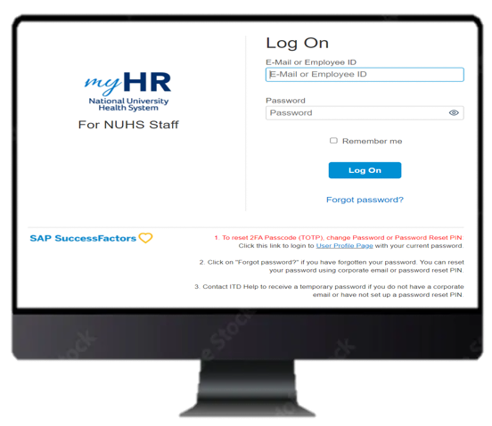
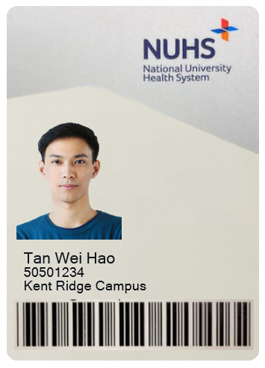
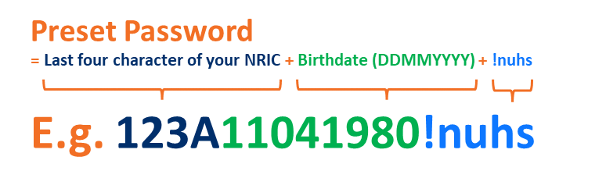
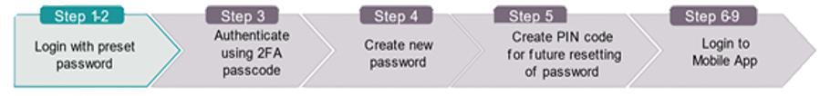
Request for myHR Account activation for 1st time
Auto-default initial myHR password for new hire - what is the initial password for new hire logic? – NRIC last 4 characters + Birthdate + !nuhs
Login to myHR (https://hcm44.sapsf.com/login?company=NUHS) with your Employee ID and pre-set password (expires after 14 days). Your pre-set password is a combination of Last four character of your NRIC (in uppercase for the alphabet), your Birthdate (DDMMYYYY) and !nuhs
Note: For Employee ID / Employee No. that starts with a 0, please enter the 0 as per stated on your Employee ID tag.

Slide 8
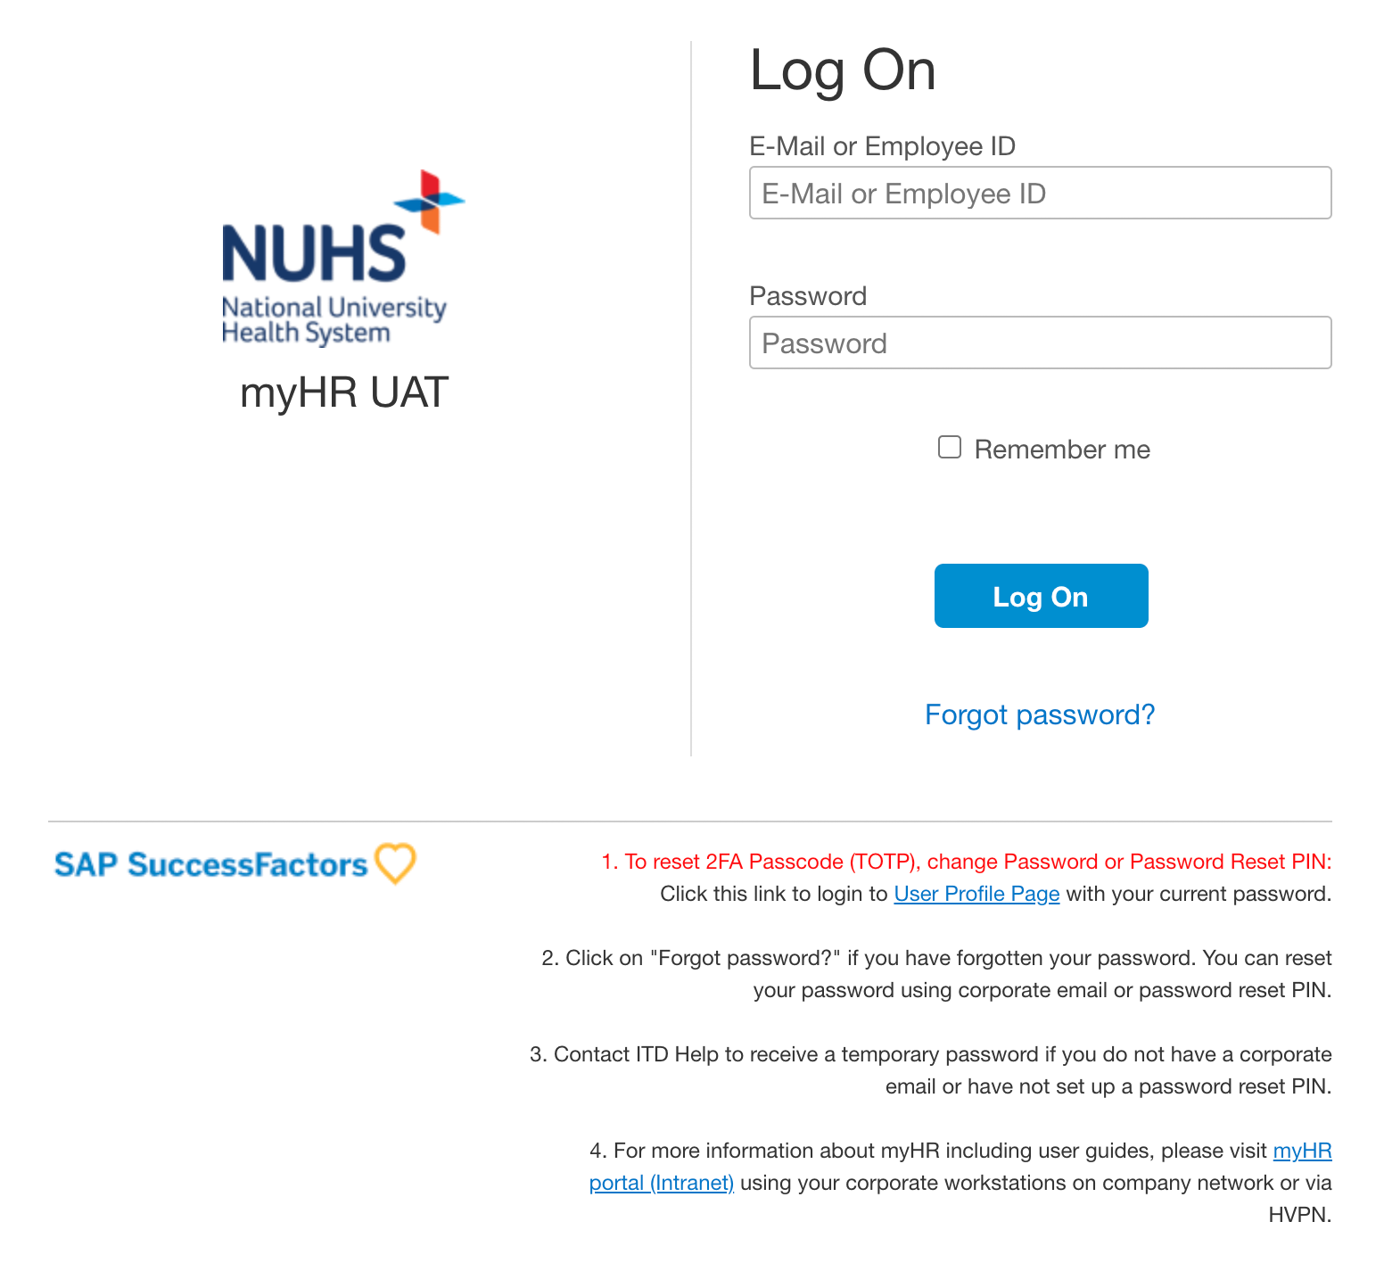

Request for myHR Account activation
Go to the myHR log on page and login with the pre-set default password (default password will expires after 14 days):
Last four character of your NRIC (in uppercase for the alphabet), your Birthdate (DDMMYYYY) and !nuhs (E.g. 123A11041980!nuhs)
After 14 days, please click on “Forget Password” on login page.
1

Slide 9
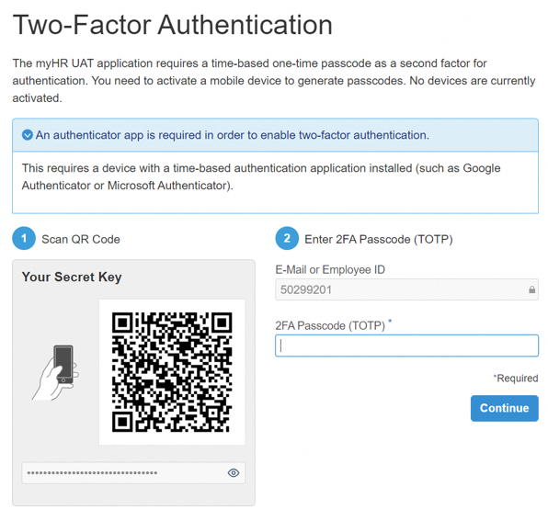
Request for myHR Account activation
Download and install SAP Authenticator mobile app in your mobile phone. Scan the QR code using your authenticator app in your device.
Then, key in the 2FA Passcode generated from the authenticator app in your device and click “Activate”.
2

Slide 10
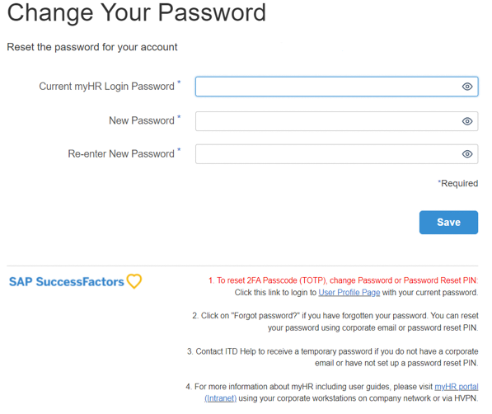
Request for myHR Account activation
Fill in your current password and the new password. Then, click ”Save”.
*For current password, it is the default password which has been pre-set (default password will expires after 14 days):
Last four character of your NRIC (in uppercase for the alphabet), your Birthdate (DDMMYYYY) and !nuhs (E.g. 123A11041980!nuhs)
3

Slide 11
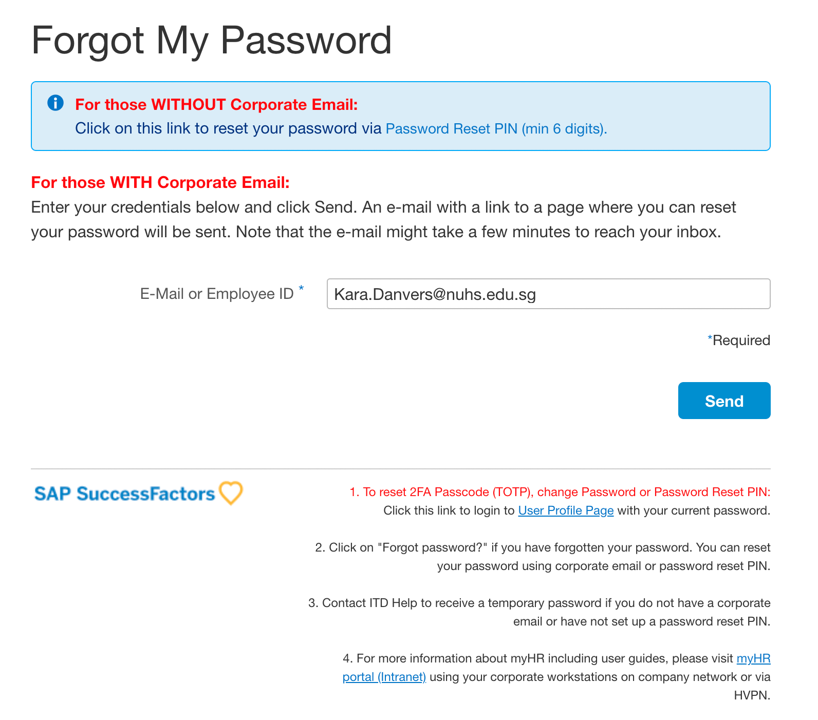
Request for myHR Account activation
After 14 days, under “For those WITH Corporate Email:” section, fill in your E-Mail or Employee ID and click the ”Send” button.
If you’re already registered in the system, you will receive an email within 10 minutes. The email contains a confidential link where you can reset your password and will expire in 2 hours upon being sent.
For staff without NUHS Corporate email, please call IT Service Desk (800 321 2111) to request for activation. Thereafter, go to the myHR URL webpage and log in using your given password.
4

Slide 12
Setup your myHR Account & 2FA
- For iOS Users
When:
1st Time set up
Change of Mobile Device

Slide 13
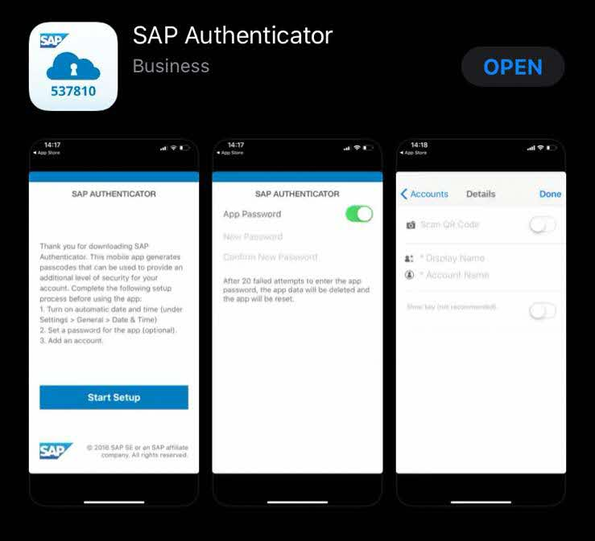
Setup your myHR Account & 2FA (For iOS Users)
Download the SAP Authenticator via App Store on your mobile device.
Ensure you have your internet device (e.g., your tablet or internet-facing PC) before you commence.
1
2
Important:You will need 2 internet enabled devices, including your mobile phone to activate and initialize your acct/mobile app for the firsttime.

Slide 14
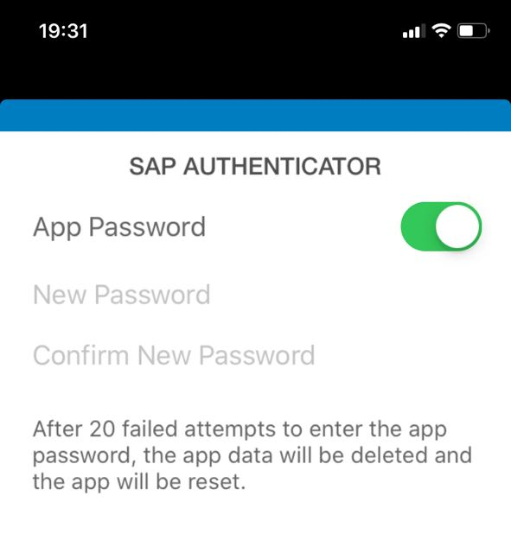
Setup your myHR Account & 2FA (For iOS Users)
Set up an “account” on SAP Authenticator App and switch the “Use App Password” function off.
Note that if you keep app password ON then every time you open the App you need to enter the password.
In case you turn ON the App Password and want to Switch Off please refer this slide.
3

Slide 15
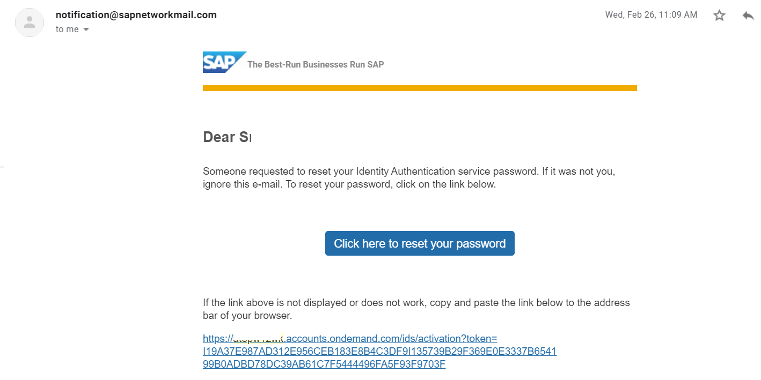
Setup your myHR Account & 2FA (For iOS Users)
Upon creation of your account, you will receive an email. Open the Password Reset Email on an Internet enabled device.
You can login to your corporate email account via www.hmail.sg on the internet-enabled device and click on the email link above.
4

Slide 16
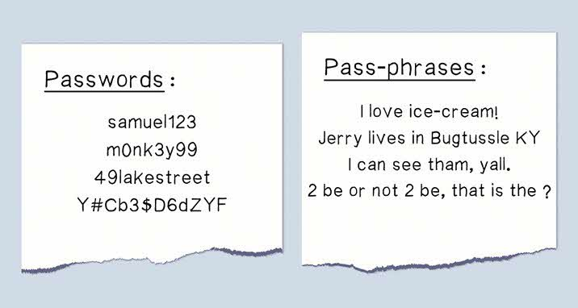
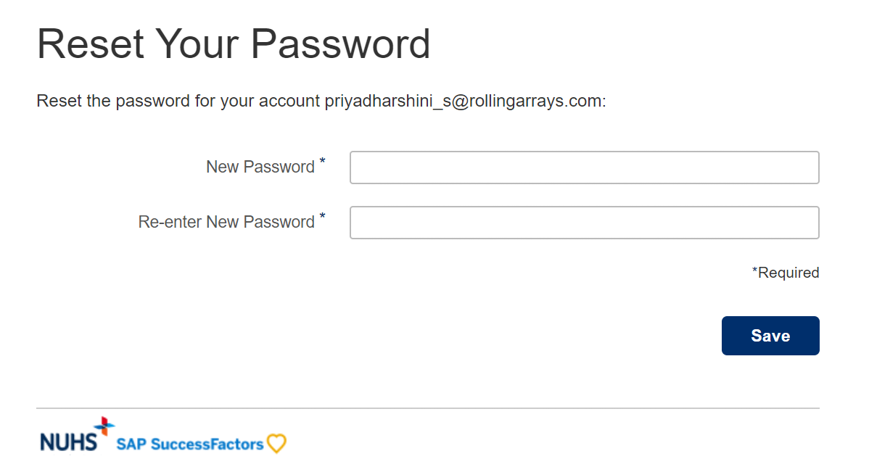
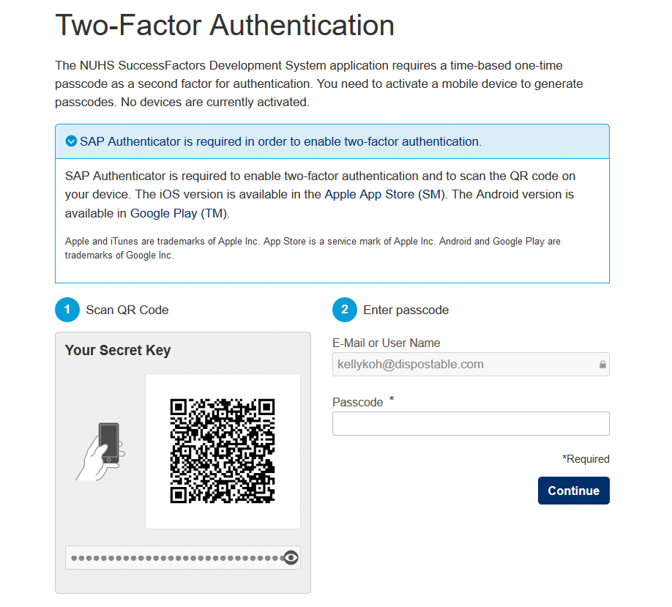
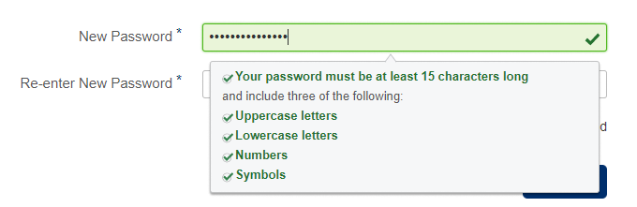
Setup your myHR Account & 2FA (For iOS Users)
Enter your new passwords and click on “Save”.
Note: The password must be 12 characters long with a mix of upper-case letters, lower case letters, numbers and special character. It is recommended to use “pass-phrases” instead of “password” due to the length.
You will be directed to the screen with the QR Code.
5
6
12
Please use laptop/ desktop/ iPad for login via browser.
Do not use Mobile Phone to login via browser.

Slide 17


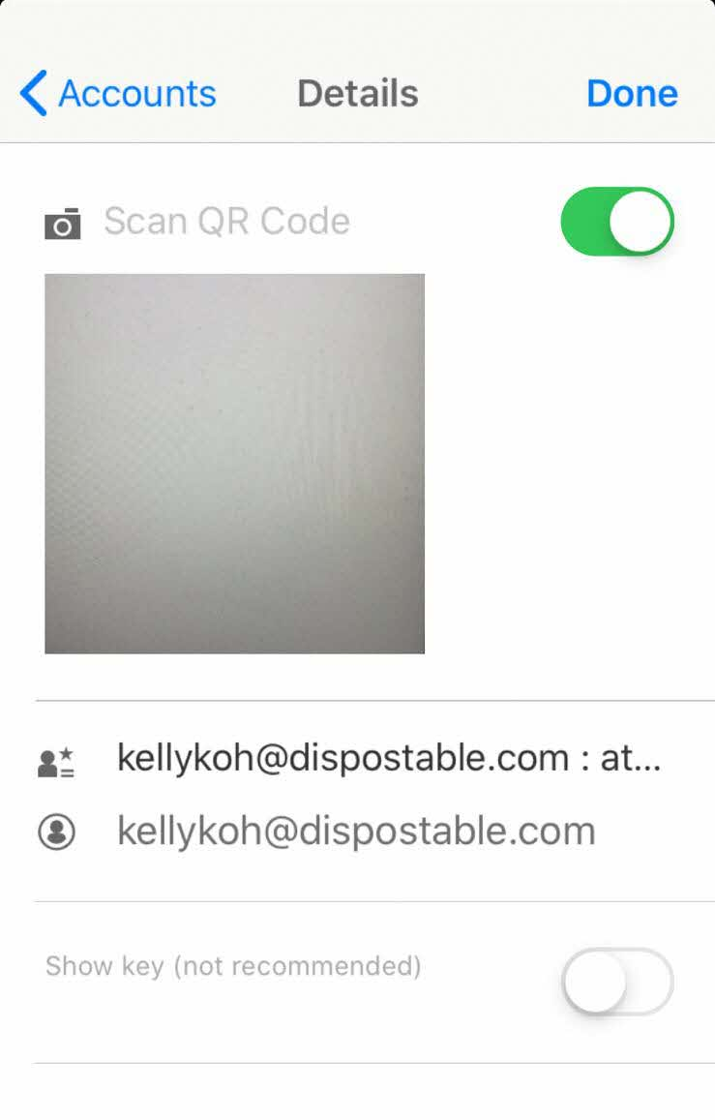
Setup your myHR Account & 2FA (For iOS Users)
On your mobile phone, click on the SAP Authenticator -> Add New Account -> Select ‘Scan QR code’.
Scan QR Code from the screen
7
8
Please use laptop/ desktop/ iPad for login via browser.
Do not use Mobile Phone to login via browser.

Slide 18
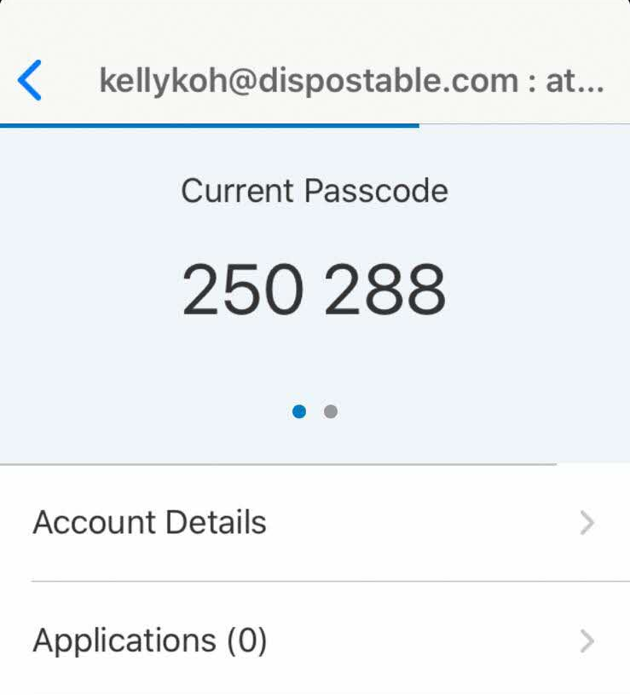
Setup your myHR Account & 2FA (For iOS Users)
9
Enter the unique passcode from the SAP Authenticator into the Passcode on the screen and click on “Continue”

Slide 19
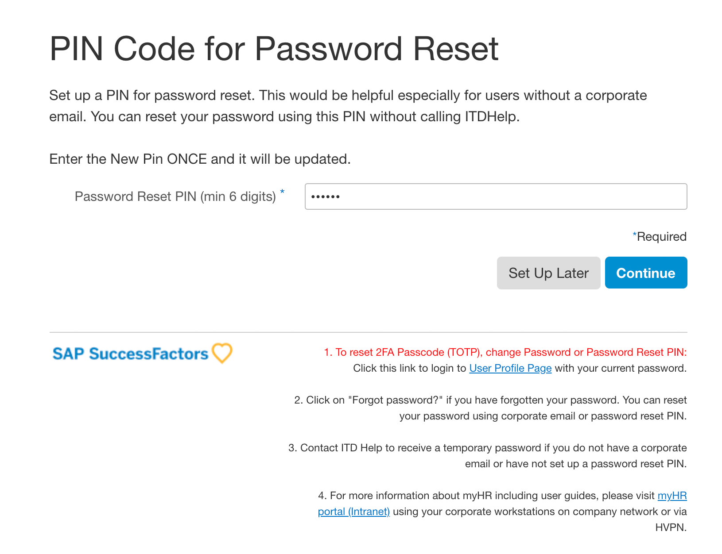
Setup your myHR Account & 2FA (For iOS Users)
The system will also prompt user to set up your Password Reset PIN.
Fill in the Password Reset PIN that you want (minimum 6 digits of number) and click “Continue”.
Optionally, you can click “Set Up Later” if you do not want to set up your Password Reset PIN now. Note that you will still be prompted every time you log on if you are yet to set up your Password Reset PIN.
10

Slide 20
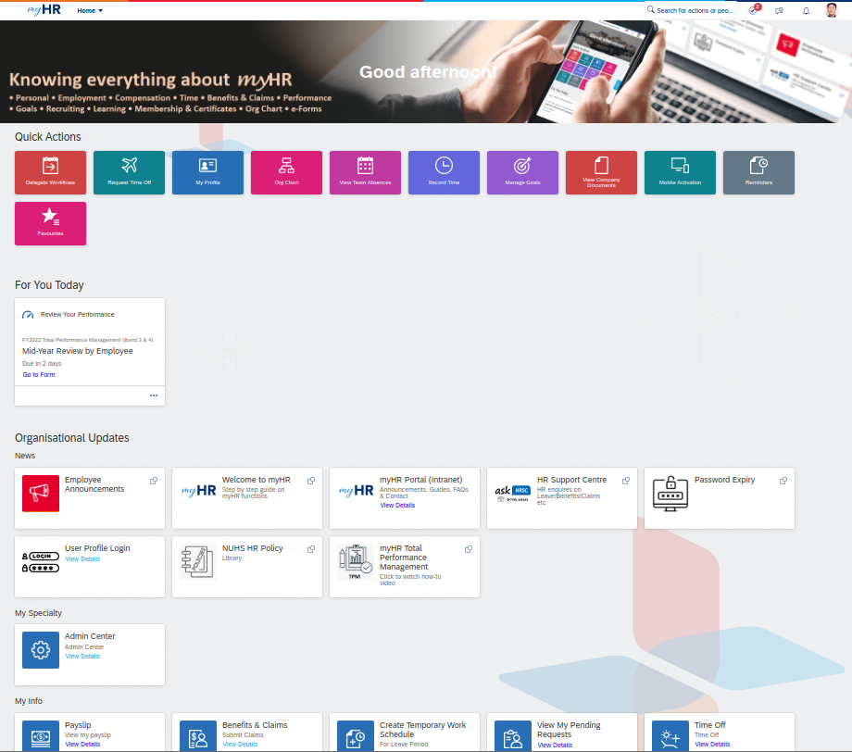
Setup your myHR Account & 2FA (For iOS Users)
You have successfully activated your account/reset the password.
For future logins, use the myHR system URL to login to myHR (Please see next slide for more details)
https://hcm44.sapmyHR.com/login?company=NUHS#/login
11

Slide 21
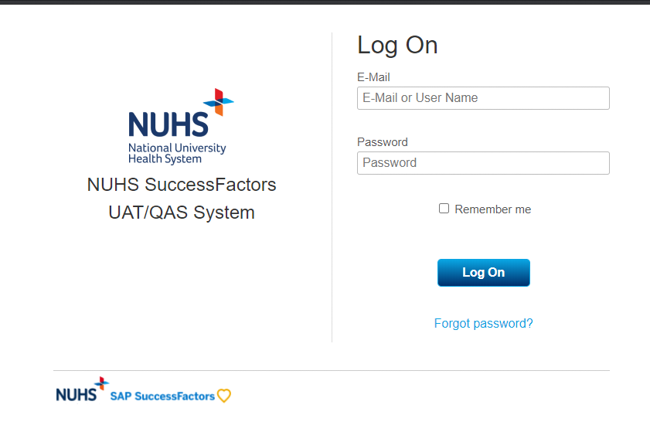
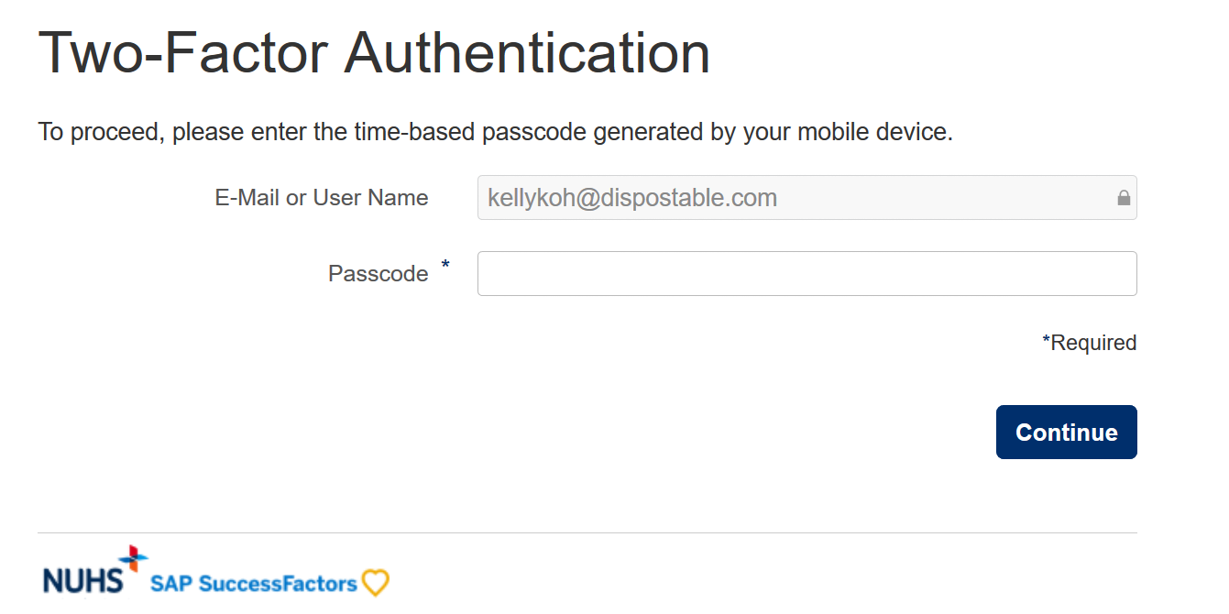
Setup your myHR Account & 2FA (For iOS Users): Login to myHR via Browser
Go to the myHR web-page at https://hcm44.sapmyHR.com/login?company=NUHS#/login
Enter the username and 12 characters password.
Click on the SAP Authenticator application to generate the 2FA passcode
Enter the app password (only applicable for those users who kept the App Password setting ON )
Enter the 6-digit passcode in the second screen and click “Continue” to login to myHR.

Slide 22
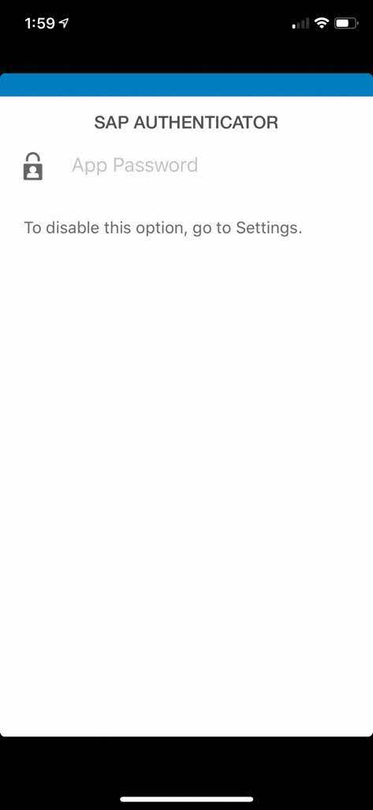
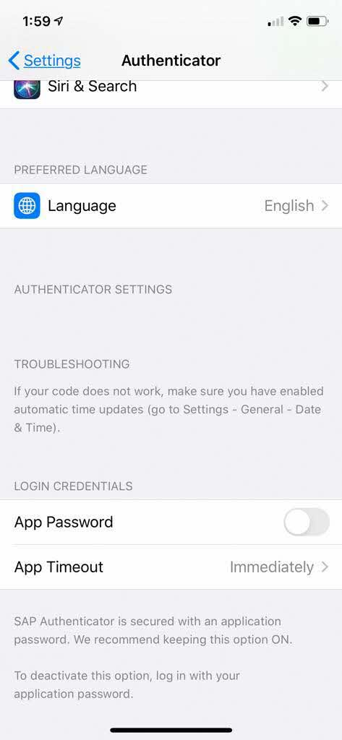
Setup your myHR Account & 2FA (For iOS Users): Resetting password settings for SAP Authenticator App
In scenario you have set the App password ON , you can only switch off by going to your iPhone settings as shown below

Slide 23
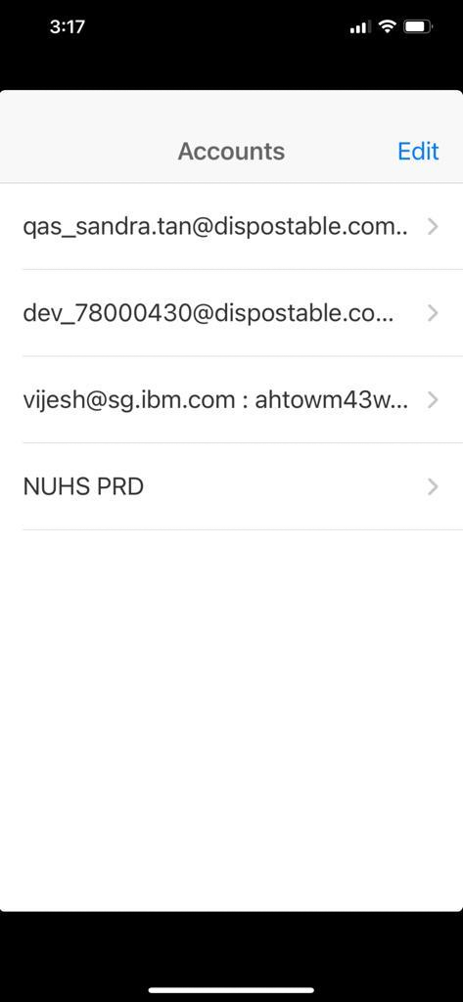
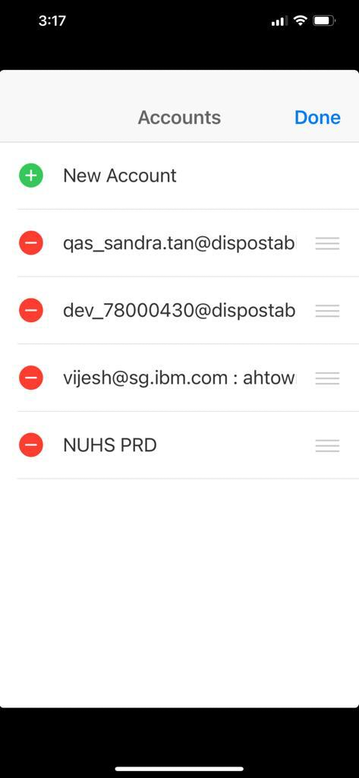

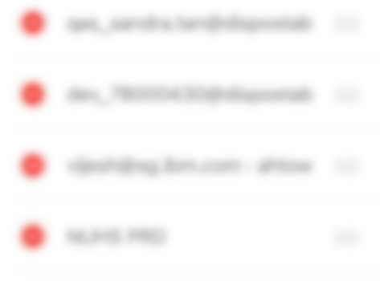
Setup your myHR Account & 2FA (For iOS Users): Adding additional OTP to SAP Authenticator App

Slide 24
Setup your myHR Account & 2FA
- For Android Users
When:
1st Time set up
Change of Mobile Device

Slide 25
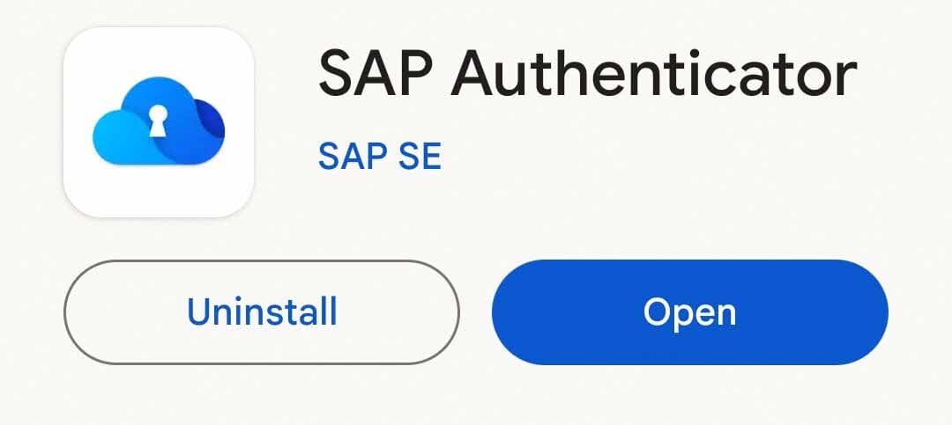
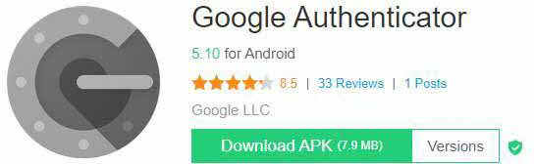
Setup your myHR Account & 2FA (For Android Users)
Download the SAP Authenticator via App Store on your mobile device.
Ensure you have your internet device (e.g., your tablet or internet-facing PC) before you commence.
1
For Huawei phones without Google services:
Download the Google Authenticator (use as SAP Authenticator as a 2FA app) via internet browser at https://apkpure.com/google-authenticator/com.google.android.apps.authenticator2
2
Important:You will need 2 internet enabled devices, including your mobile phone to activate and initialize your acct/mobile app for the firsttime.

Slide 26
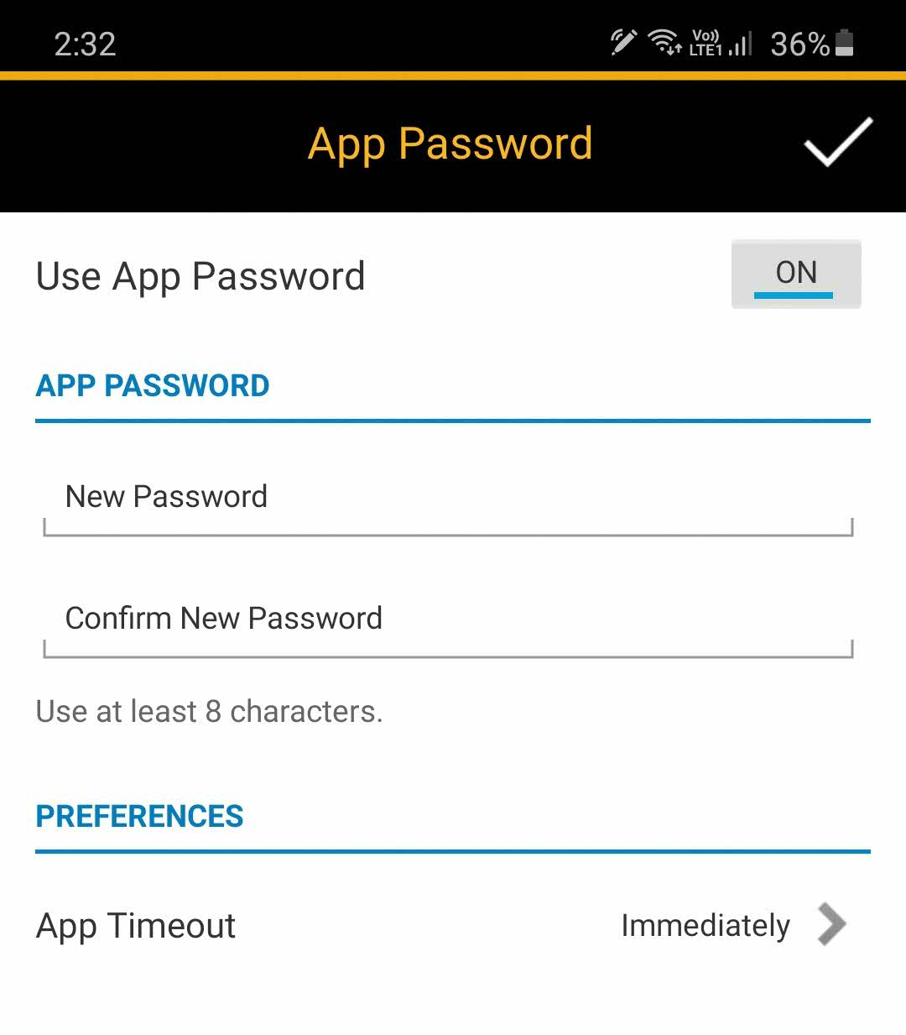
Setup your myHR Account & 2FA (For Android Users)
Set up an “account” on SAP Authenticator App and switch the “Use App Password” function off.
Note that if you keep app password ON then every time you open the App you need to enter the password.
In case you turn ON the App Password and want to Switch Off please refer this slide.
3

Slide 27
Setup your myHR Account & 2FA (For Android Users)
Upon creation of your account, you will receive an email. Open the Password Reset Email on an Internet enabled device.
You can login to your corporate email account via www.hmail.sg on the internet-enabled device and click on the email link above.
4

Slide 28
Setup your myHR Account & 2FA (For Android Users)
Enter your new passwords and click on “Save”.
Note: The password must be 12 characters long with a mix of upper-case letters, lower case letters, numbers and special character. It is recommended to use “pass-phrases” instead of “password” due to the length.
You will be directed to the screen with the QR Code.
5
6
12
Please use laptop/ desktop/ iPad for login via browser.
Do not use Mobile Phone to login via browser.

Slide 29
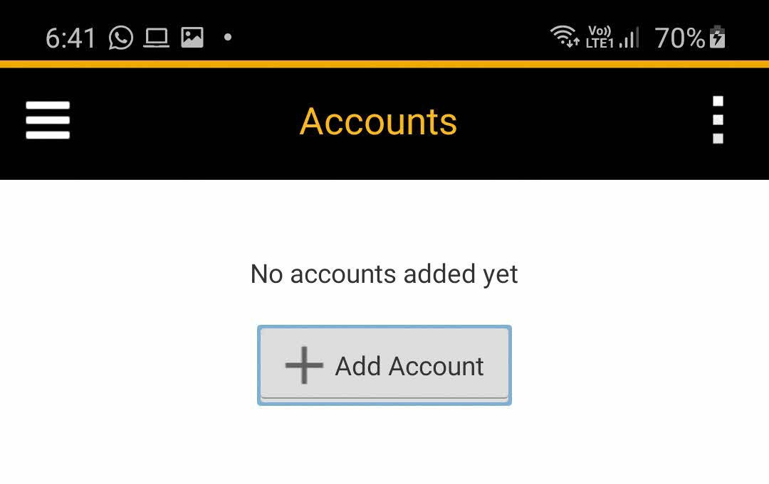
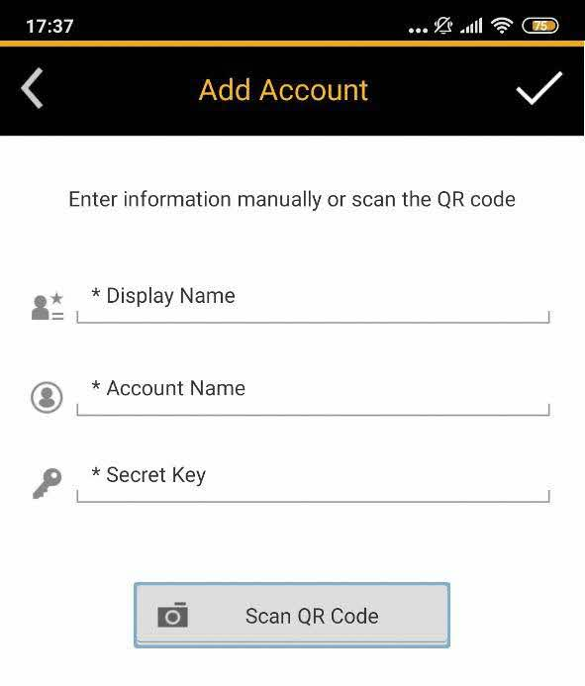
Setup your myHR Account & 2FA (For Android Users)
On your mobile phone, open SAP Authenticator -> Add Account -> Select ‘Scan QR code’.
Scan QR Code from the screen
7
8
Please use laptop/ desktop/ iPad for login via browser.
Do not use Mobile Phone to login via browser.

Slide 30
Setup your myHR Account & 2FA (For Android Users)
9
Enter the unique passcode from the SAP Authenticator into the Passcode on the screen and click on “Continue”

Slide 31
Setup your myHR Account & 2FA (For Android Users)
The system will also prompt user to set up your Password Reset PIN.
Fill in the Password Reset PIN that you want (minimum 6 digits of number) and click “Continue”.
Optionally, you can click “Set Up Later” if you do not want to set up your Password Reset PIN now. Note that you will still be prompted every time you log on if you are yet to set up your Password Reset PIN.
10

Slide 32
Setup your myHR Account & 2FA (For Android Users)
You have successfully activated your account/reset the password.
For future logins, use the myHR system URL to login to myHR (Please see next slide for more details)
https://hcm44.sapmyHR.com/login?company=NUHS#/login
11

Slide 33
Setup your myHR Account & 2FA (For Android Users): Login to myHR via Browser
Go to the myHR web-page at https://hcm44.sapmyHR.com/login?company=NUHS#/login
Enter the username and 12 characters password.
Click on the SAP Authenticator application to generate the 2FA passcode
Enter the app password (only applicable for those users who kept the App Password setting ON )
Enter the 6 digit passcode in the second screen and click “Continue” to login to myHR.

Slide 34
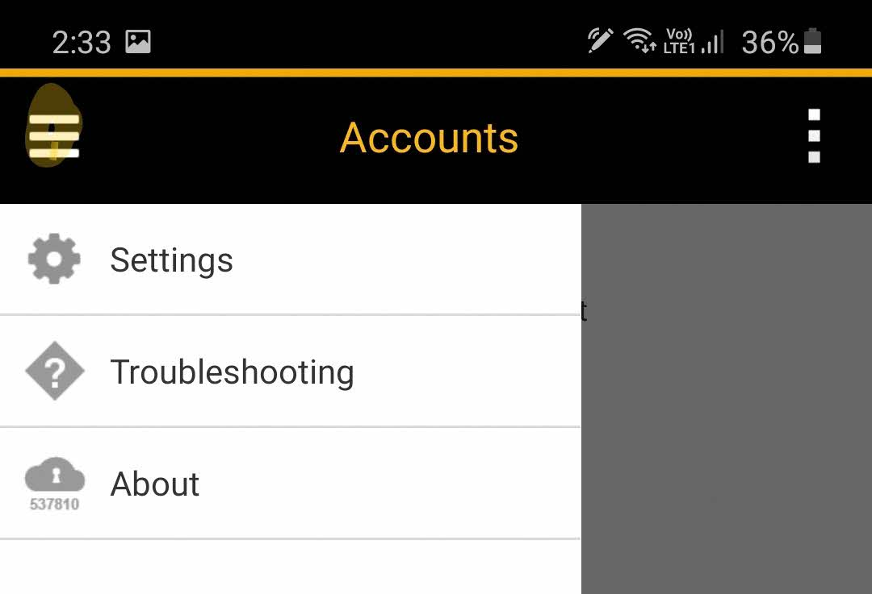
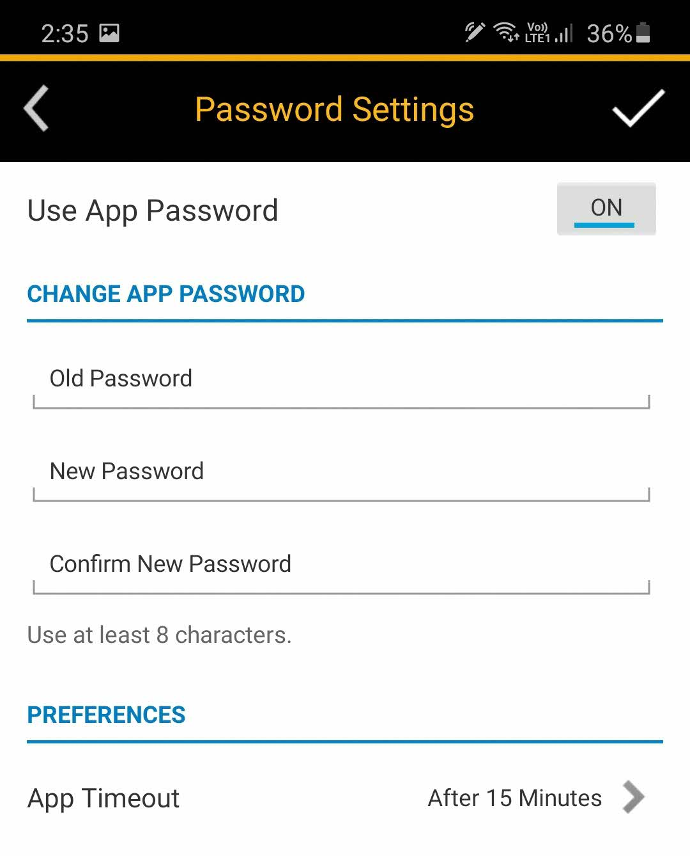
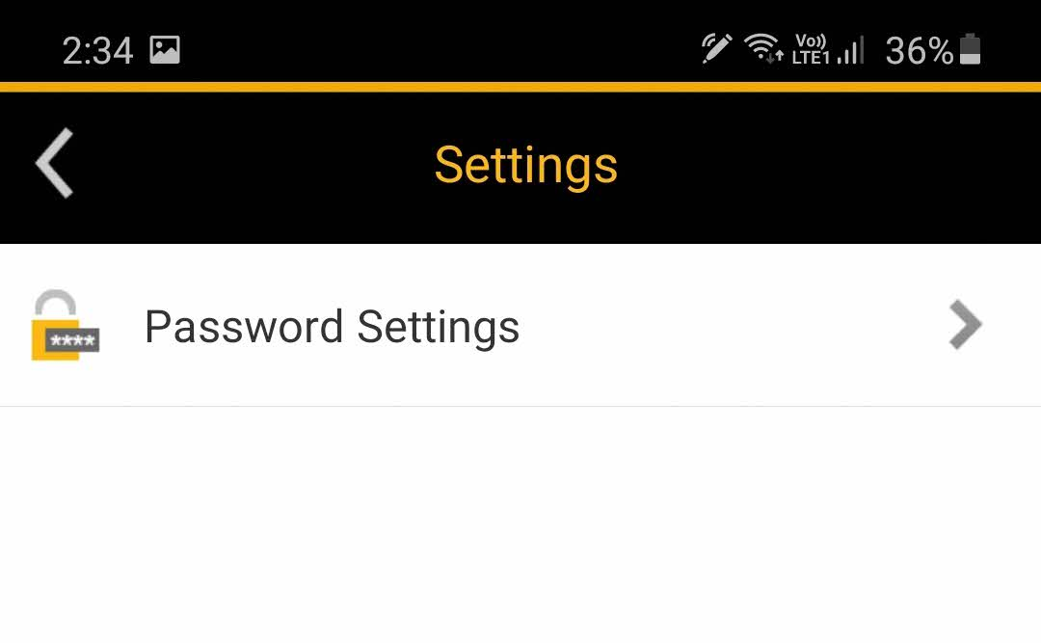
Setup your myHR Account & 2FA (For Android Users): Resetting password settings for SAP Authenticator App
Click on the icon at the top left corner-> Settings-> Password Settings.

Slide 35
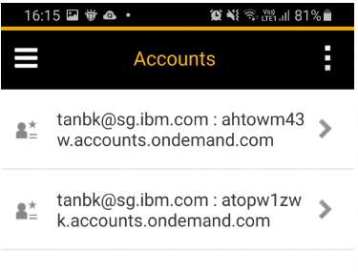
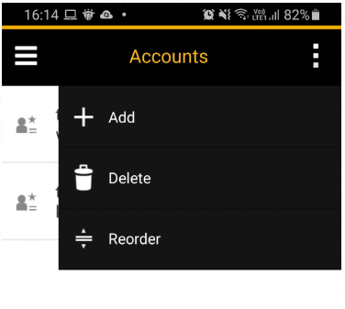
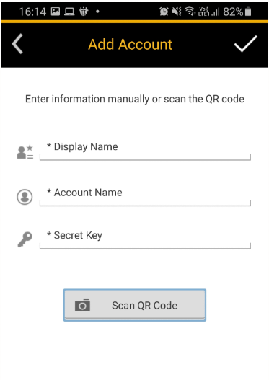

Setup your myHR Account & 2FA (For Android Users): Adding additional OTP to SAP Authenticator App
Click on the icon at the top right corner-> Add, to add an account

Slide 36
Login to myHR Mobile App
When:
1st time set up
To set up Mobile App

Slide 37
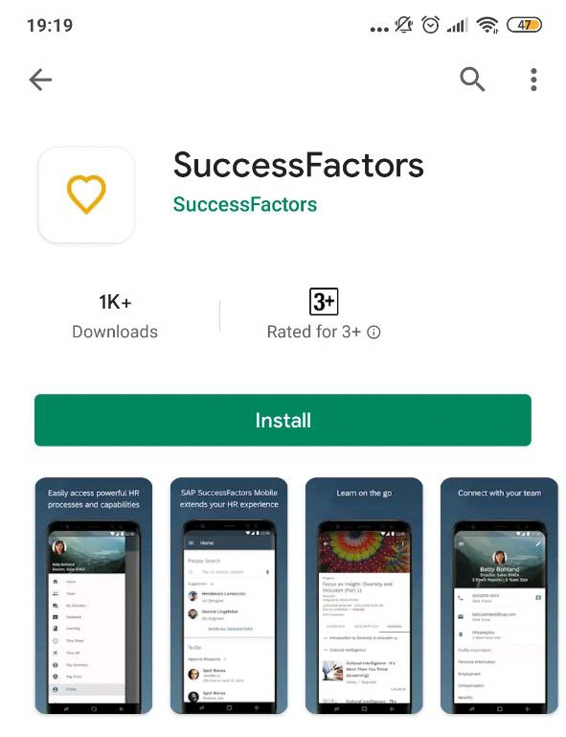
Login to myHR Mobile App
Preparation
Download the SuccessFactors Application via Play Store/ App Store on your mobile device as well.
Ensure you have your internet device (e.g., your tablet or internet-facing PC) before you commence.
For Huawei phones without Google services: please refer to this slide on how to download SAP myHR Mobile App (for Huawei phones without Google services)

Slide 38
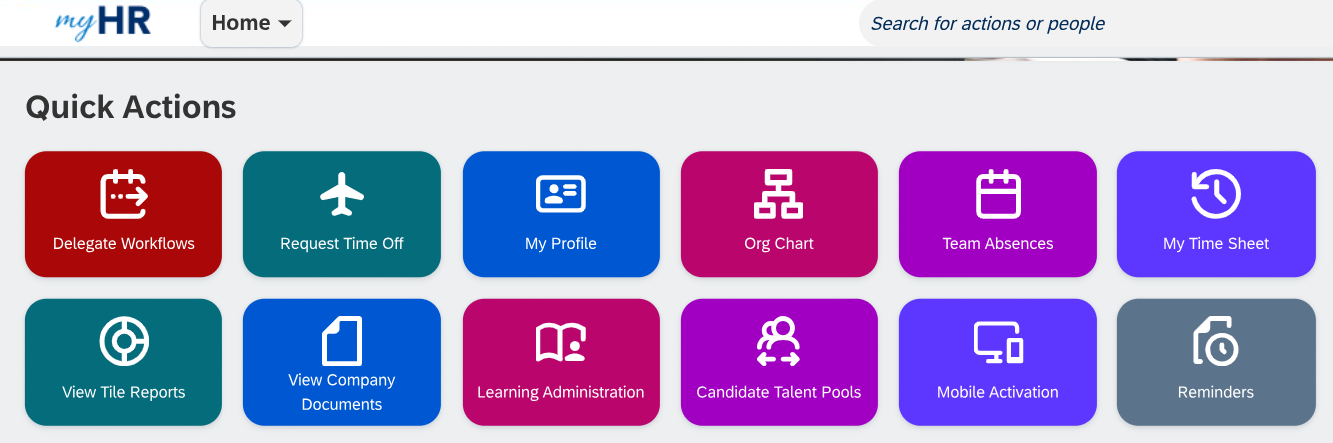
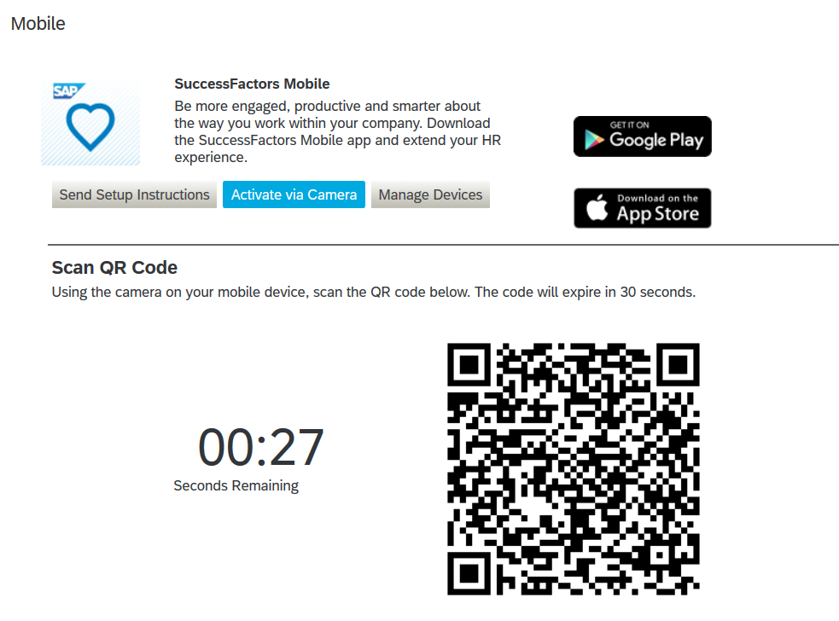
Login to myHR Mobile App
Login to myHR via a web browser -> Mobile Application -> Click on Activate via Camera -> QR code will be generated.
1

Slide 39
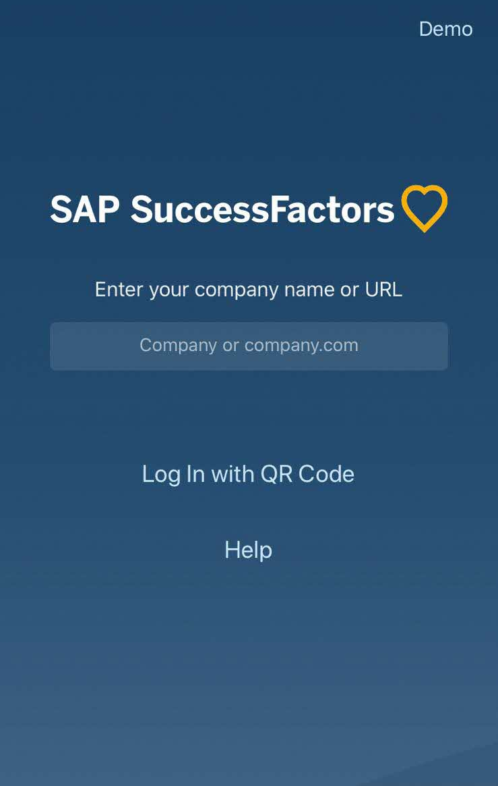
Login to myHR Mobile App
2
Please ensure you have downloaded the SuccessFactors application in your device.
From your Mobile Application, tap ‘Log In with QR Code’
Scan the QR Code shown on the screen, and you will be logged in via mobile.
Please take note that one session of login would only be valid for 6 months. After reaching the expiry date, you will be logged out from your myHR mobile app. To reset myHR mobile profile expiry, see here.
3
Please use laptop/ desktop/ iPad for login via browser.
Do not use Mobile Phone to login via browser.

Slide 40
Download myHR Mobile App (for Huawei phones without Google services)
When:
1st time set up
To set up Mobile App

Slide 41

Download myHR Mobile App (for Huawei phones without Google services)
As SAP only officially supports iOS through App Store and Android through Google Play Store, the following method is a third-party software workaround.
Download and install Tencent App Store via Huawei App Gallery or the internet browser on your device.
1

Slide 42
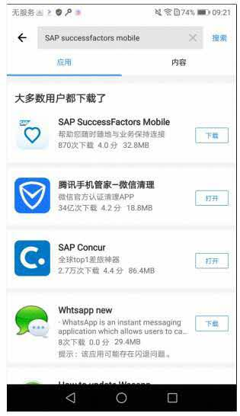
Download myHR Mobile App (for Huawei phones without Google services)
Open Tencent App Store and search full name “SAP SuccessFactors Mobile”
Click the “下载“ (Download) button
IMPORTANT: Due to Tencent limits, currently the app can only be found by searching full name ‘SAP SuccessFactors Mobile’. Assembly team is communicating with Tencent to have further statement on this through an official channel and to have the app searchable without its full name.
2

Slide 43
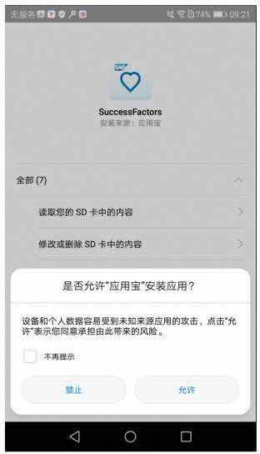
Download SAP SuccessFactors Mobile App (for Huawei phones without Google services)
Click the “允许“ (Allow) button to continue with the installation
3

Slide 44
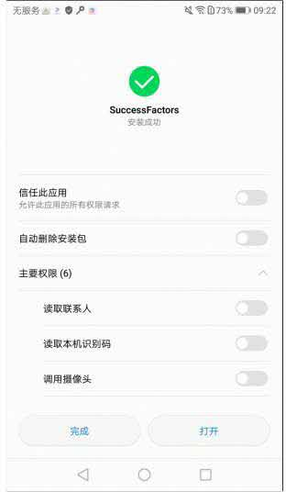
Download SAP SuccessFactors Mobile App (for Huawei phones without Google services)
After the installation is completed, click “打开” (Open) to launch the SAP myHR Mobile app.
4

Slide 45
Activate Multiple Profile Feature in myHR Mobile
When:
Setting up multiple profiles in iOS and Android

Slide 46
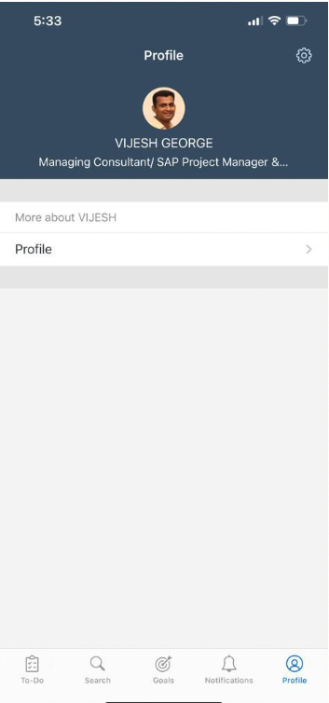
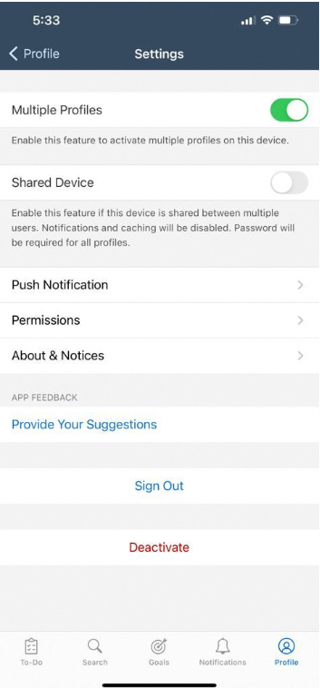
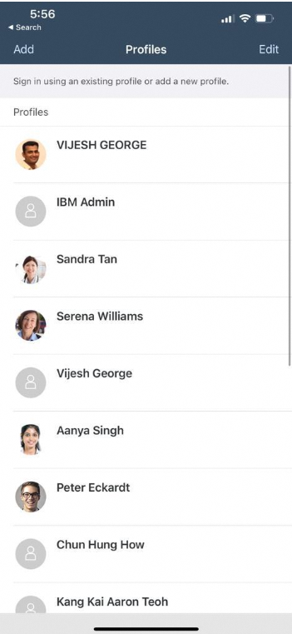
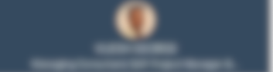
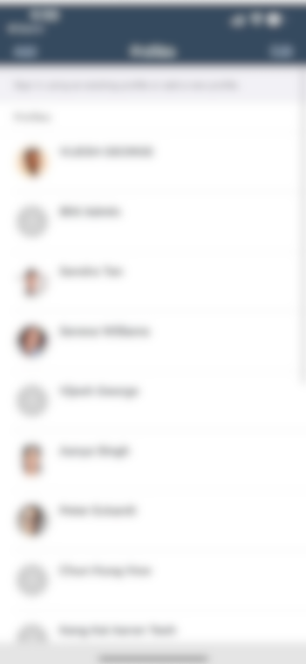
Activate Multiple Profile Feature in myHR Mobile (For iOS Users)
Load the SAP myHR Mobile app and go to your profile.
Click on Settings
Switch on the “Multiple Profile” features
Kill the app and reload the SAP myHR Mobile app again.
Click on the “Add” button and scan the QR Code.

Slide 47



Activate Multiple Profile Feature in myHR Mobile (For Android Users)
Load the SAP myHR Mobile app and go to your profile.
Click on Settings
Switch on the “Multiple Profile” features
Kill the app and reload the SAP myHR Mobile app again.
Click on the “Add” button and scan the QR Code.

Slide 48
Reset myHR Mobile Profile Expiry after 6 Months
When:
Extend mobile profile expiry

Slide 49
Reset myHR Mobile Profile Expiry
To reset your mobile profile expiry to another 6 months (180 days), log in to myHR via a web browser on a separate internet enabled device e.g., Internet accessible laptop or mobile tablet
Go to ”Mobile Application” tile found in the Homepage and click on “Activate via Camera”. A QR code will be generated.
1

Slide 50
Reset myHR Mobile Profile Expiry
2
3
Launch your myHR application in your device and tap ‘Log In with QR Code’
Scan the QR Code shown on your Internet accessible laptops or mobile tablet’s screen, you will be logged in and mobile profile expiry will be renewed for another 6 months (180 days)
Please use a separate Internet accessible laptop or mobile tablet for login viabrowser.
Do not use mobile phone to login viabrowser.

Slide 51
Login to myHR Web Browser
When:
Log in to myHR browser

Slide 52

Login to myHR Web Browser
Go to the myHR log on page. https://hcm44.sapsf.com/login?company=NUHS
Fill in your credentials (E-Mail/ Employee ID and Password) and click “Log on” button
1

Slide 53

Login to myHR Web Browser
You will then be required to perform two-factor authentication. Open your authenticator app on your mobile device. Key in the current 2FA code into your myHR web browser and click “Continue”
2

Slide 54
Activate your Password Reset PIN
When:
Log in to myHR browser

Slide 55
Activate your Password Reset PIN
Go to the myHR log on page. Fill in your credentials (E-Mail/ Employee ID and Password) and click “Log on” button
1

Slide 56
Activate your Password Reset PIN
If you have not set up your Password Reset PIN before, the system will prompt you to set it up immediately.
Fill in the Password Reset PIN that you want (minimum 6 digits of number) and click “Continue”.
Optionally, you can click “Set Up Later” if you do not want to set up your Password Reset PIN now. Note that you will still be prompted every time you log on if you are yet to set up your Password Reset PIN.
2

Slide 57


Activate your Password Reset PIN
(3a) You can set up your Password Reset PIN through User Profile Page which can be accessed from the log on page
(3b) Alternatively, you can log on to myHR and click “User Profile” under the “News” section. This will redirect you to the User Profile Page.
3a
3b

Slide 58


Activate your Password Reset PIN
Once User Profile Page interface appears, scroll down until you see the section “PIN Code for Password Reset” and click “Edit”.
Fill in your current my HR Login Password as well as the Password Reset PIN that you want (minimum 6 digits of number), then click “Save” to proceed.
4
5

Slide 59
Change your password using corporate email
To do this, you will need to have access to your corporate email.

Slide 60
Change your password using corporate email
Go to the myHR log on page and click on “Forgot password?”
1

Slide 61
Change your password using corporate email
Under “For those WITH Corporate Email:” section, fill in your E-Mail or Employee ID and click the ”Send” button.
You will receive an email within 10 minutes. The email contains a confidential link where you can reset your password and will expire in 2 hours upon being sent.
For staff without NUHS Corporate email, you could change your password using Password Reset PIN if you have set it up before or call IT Service Desk (800 321 2111) to request for password reset.
2

Slide 62
Change your password using Password Reset PIN
To do this, you must have set up your Password Reset PIN before and remember it.

Slide 63
Change your password using Password Reset PIN
Go to the myHR log on page and click on “Forgot password?”
1

Slide 64
Change your password using Password Reset PIN
Under “For those WITHOUT Corporate Email:”, click Password Reset PIN (min 6 digits).
2

Slide 65


Change your password using Password Reset PIN
Key in your E-Mail/ Employee ID and your password reset PIN, then click “Continue”.
You might be needed to perform 2FA by keying in 2FA Passcode (TOTP) generated by your mobile authenticator app
3
4

Slide 66

Change your password using Password Reset PIN
Key in your new password twice and click “Save”.
5

Slide 67
Change your password through User Profile Page
To access the User Profile Page, you will need to have access to your active myHR password (before 6 months expiry) to login into the system.

Slide 68
Change your password through User Profile Page
(1a) Go to the myHR log on page and click on the link “User Profile Page”.
1a

Slide 69

Change your password through User Profile Page
(1b) You will be redirected to another log on interface for User Profile. Fill in your credentials (E-Mail/Employee ID and password) and click “Log On”.
1b

Slide 70
Change your password through User Profile Page
Alternatively, you can log on to myHR and click “User Profile” under the “News” section. This will redirect you to the User Profile Page.
2

Slide 71


Change your password through User Profile Page
After logging in, you will see the User Profile Page interface. Scroll down until you see the section “Password” and click on the Edit button.
Fill in your current my HR Login Password as well as your new password twice, then click “Save” to proceed with the new password.
Note that you can only change your password once every 24 hours.
3
4

Slide 72
Reset password after 6 months password expiry
When:
Log in to myHR browser

Slide 73

Reset password after 6 months password expiry
Every 6 months, employee will be prompted to change password when logging in.
1

Slide 74

Reset password after 6 months password expiry
Fill in your current password and the new password. Then, click ”Save”.
2

Slide 75
Change your Password Reset PIN through User Profile Page
When:
Log in to myHR browser

Slide 76
Change your Password Reset PIN through the User Profile Page
(1a) Go to the myHR log on page and click on the link “User Profile Page”.
1a

Slide 77
Change your Password Reset PIN through the User Profile Page
(1b) You will be redirected to another log on interface for User Profile. Fill in your credentials (E-Mail/Employee ID and password) and click “Log On”.
1b

Slide 78
Change your Password Reset PIN through the User Profile Page
Alternatively, you can log on to myHR and click “User Profile” under the “News” section. This will redirect you to the User Profile Page.
2

Slide 79


Change your Password Reset PIN through the User Profile Page
Once User Profile Page interface appears, scroll down until you see the section “PIN Code for Password Reset” and click the Edit button.
Fill in your current my HR Login Password as well as the new Password Reset PIN that you want (minimum 6 digits of number), then click “Save” to proceed with the new PIN.
3
4

Slide 80
Change/ deactivate your 2FA device through User Profile Page
When:
Log in to myHR browser

Slide 81
Change/ deactivate your 2FA device through User Profile Page
(1a) Go to the myHR log on page and click on the link “User Profile Page”.
1a

Slide 82
Change/ deactivate your 2FA device through User Profile Page
(1b) You will be redirected to another log on interface for User Profile. Fill in your credentials (E-Mail/Employee ID and password) and click “Log On”.
1b

Slide 83
Change/ deactivate your 2FA device through User Profile Page
Alternatively, you can log on to myHR and click “User Profile” under the “News” section. This will redirect you to the User Profile Page.
2

Slide 84

Change/ deactivate your 2FA device through User Profile Page
Once User Profile Page interface appears, scroll down until you see the section “Multi-Factor Authentication”
To change 2FA device, you need to deactivate the old device first. To do this, click on the Trash icon next to ”Two-Factor Authentication - 2FA Passcode (TOTP)”
3

Slide 85

Change/ deactivate your 2FA device through User Profile Page
You will then be asked to select your deactivation channel.
(4a) If you select “Existing 2FA Passcode (TOTP)”, you must have access to your old device. You will be prompted to key in the current TOTP shown in your old device’s authenticator app. Then, click “Deactivate”.
4a
4b

Slide 86


Change/ deactivate your 2FA device through User Profile Page
(4b) If you select “Passcode by E-Mail”, you don’t need to have access to your old device, but you’ll need to have access to your corporate email, if any. Click the “Send” button and key in the 2FA Passcode sent to your corporate email. Then, click “Deactivate”.
4b
Only Applicable for staff with corporate email

Slide 87

Change/ deactivate your 2FA device through User Profile Page
After deactivating your old device, you will see the button “+” next to “Two-Factor Authentication - 2FA Passcode (TOTP)” appears. Click on this button to add your new device.
5

Slide 88


Change/ deactivate your 2FA device through User Profile Page
Scan the QR code using your authenticator app in your new device.
Then, key in the 2FA Passcode generated from the authenticator app in your new device and click “Activate”.
6

Slide 89
Thank You

